Slide 1
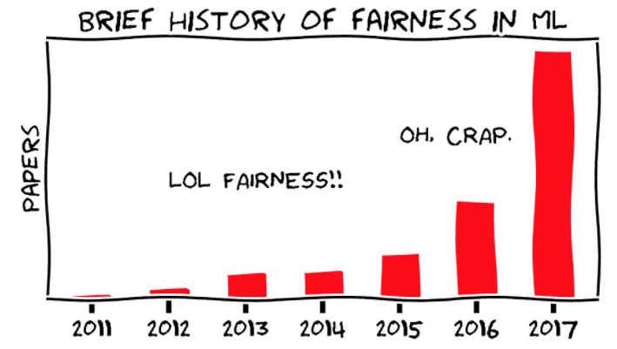
Predictive Analytics Pt. II
Lab 7

Slide 2
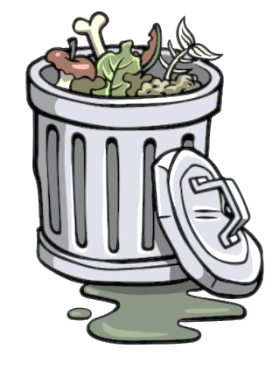
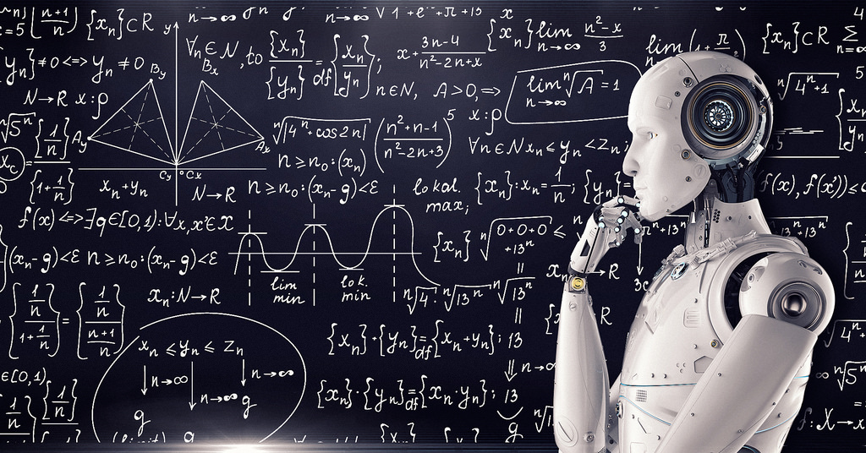
Predictive Analytics Pt. II
Lab 7
Garbage in, garbage out

Slide 3
Agenda
Revisiting the COMPAS data
Bias in predictive models – sources and strategies
Gentle introduction to neural networks
Implementing a neural network in R

Slide 4
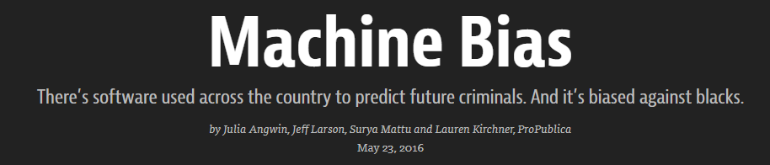
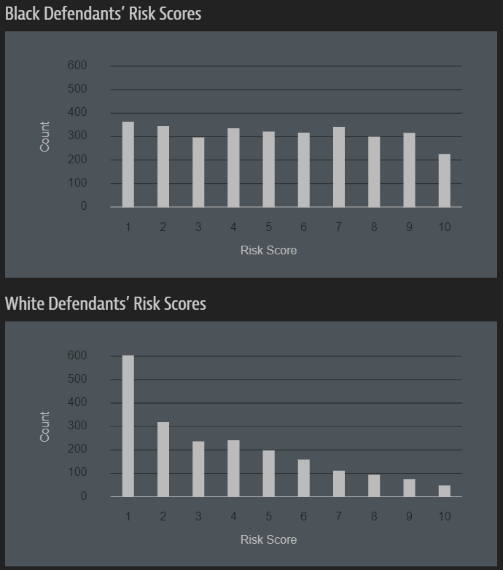
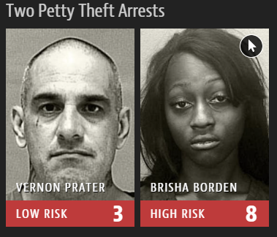
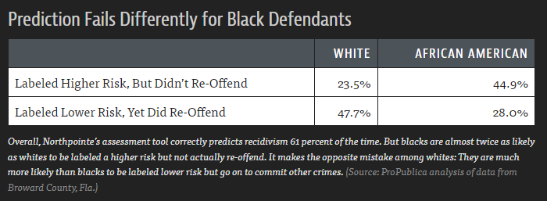
Video
Notes:
refresher for context on COMPAS, Northpointe, and ProPublica’s investigation

Slide 5
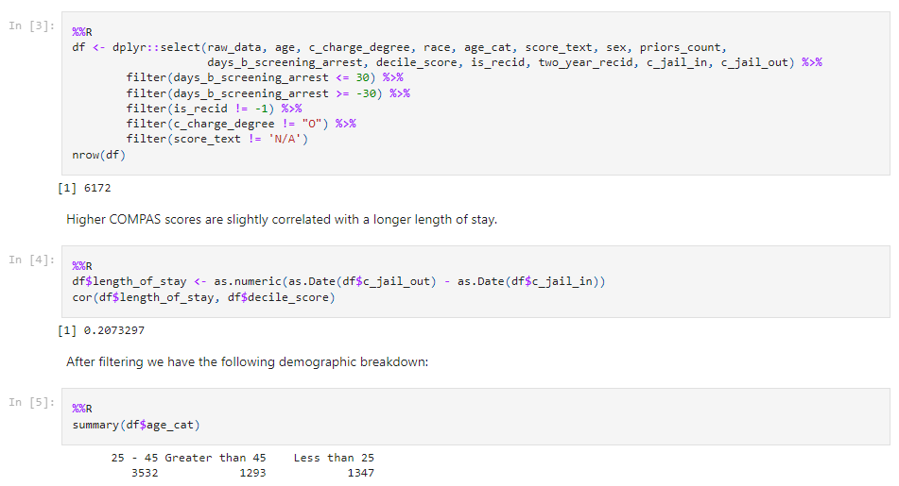
Notes:
this is standard R code to clean/wrangle (it’s basically an R markdown document [jupyter notebook])

Slide 6
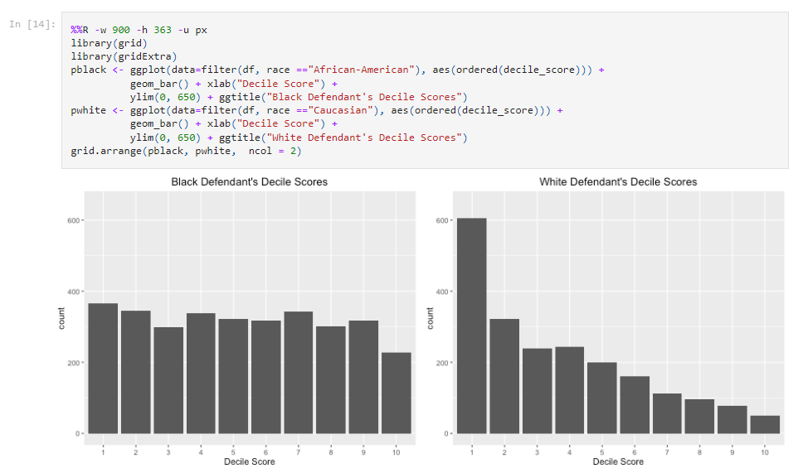
Notes:
standard ggplot code, no surprises

Slide 7
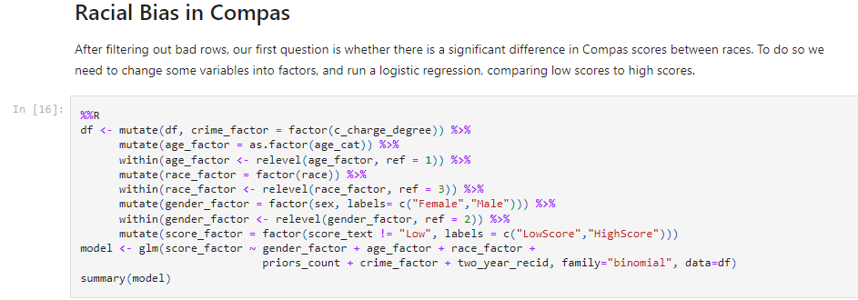
Notes:
not sure why they are predicting the score?? Also, I’m not sure they are controlling for base rate because there is no interaction term, if you know base rates differ by race, to control for it you’d need ‘race_factor * two_year_recid’ in the model. I think??

Slide 8
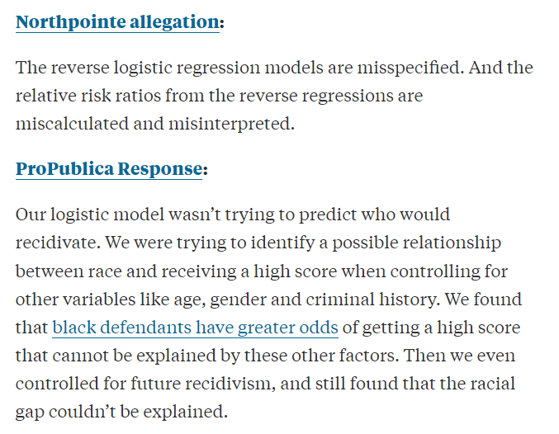

Slide 9
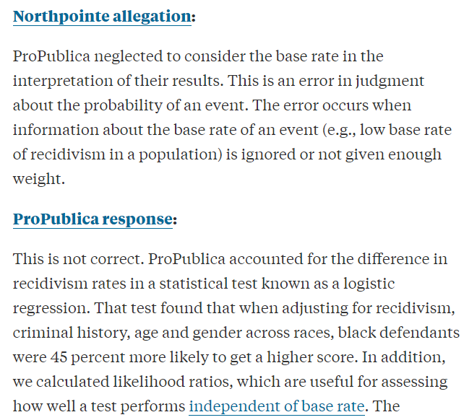
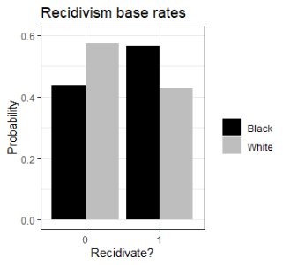

Slide 10
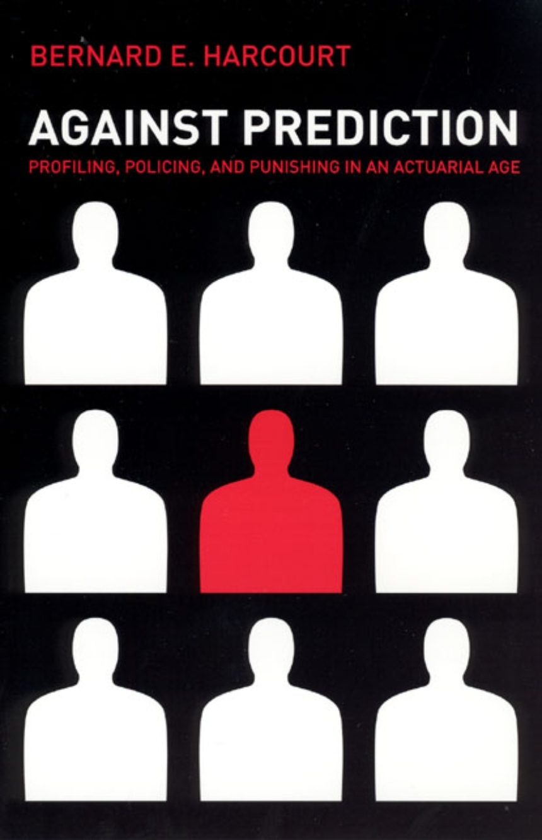
What is bias in predictive modeling?
Technical matters
Ethical matters
“Unjustified basis for differentiation”

Slide 11
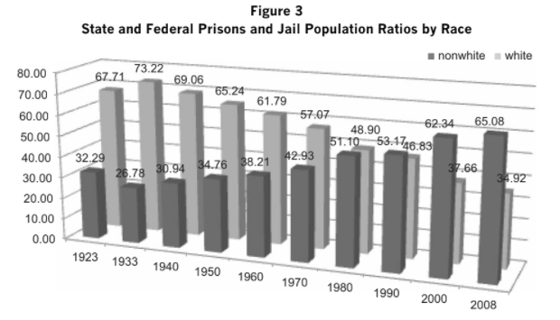
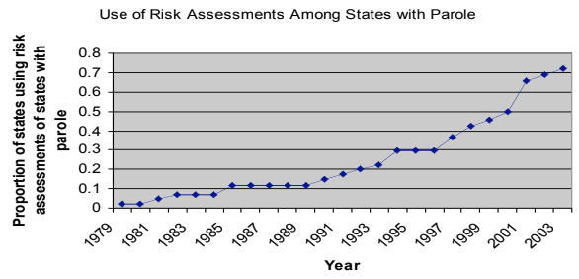
A case against prediction

Slide 12
A case against prediction
Racial disparity in justice system
Over-sampling
Predictive models assessing prior criminal records

Slide 13
Sources of bias (in models)
 | Example | Can we do anything?
Sampling bias | Participants in a study are all college students | Maybe (re-sampling)
Measurement bias | Survey asks loaded or poorly-worded questions | Maaaybe (transforming)
Systematic bias Missing data | Over-policing leads to different base rates of recidivism | Probably not
Correlated/latent variables | Amount of prior arrests correlated with race | Maybe (transforming)

Slide 14
Criteria for fairness* in prediction
Un-awareness (info on e.g. race/gender not used in prediction)
Statistical parity (same probability of outcomes)
Error ratio parity (same rates of prediction errors)
*Each come with problems, and solutions are currently debated

Slide 15
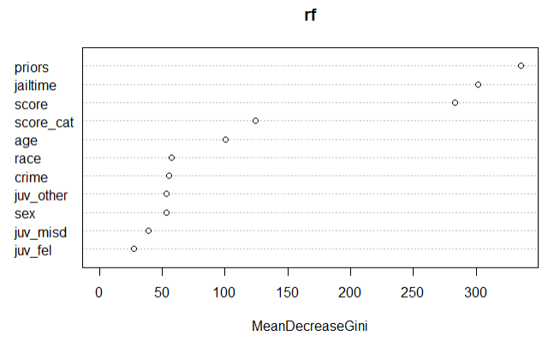
Un-awareness

Slide 16
Statistical parity – resampling on the outcome variable
Race | Recidivate?
W | 0
W | 0
W | 0
W | 1
B | 0
B | 0
B | 1
B | 1
Race | Recidivate?
W | 0
W | 1
W | 0
W | 1
B | 0
B | 1
B | 0
B | 1
25%
50%
Resample
50%
50%

Slide 17
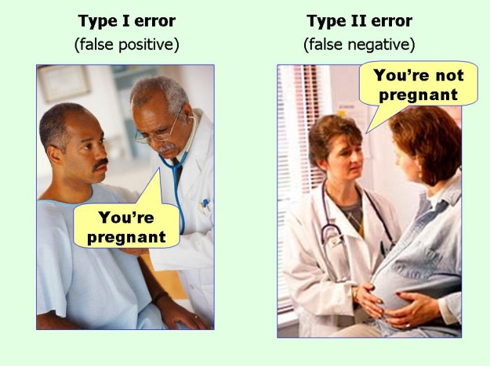
Error ratio parity
The model is wrong at some rate…
Types of errors are not the same

Slide 18
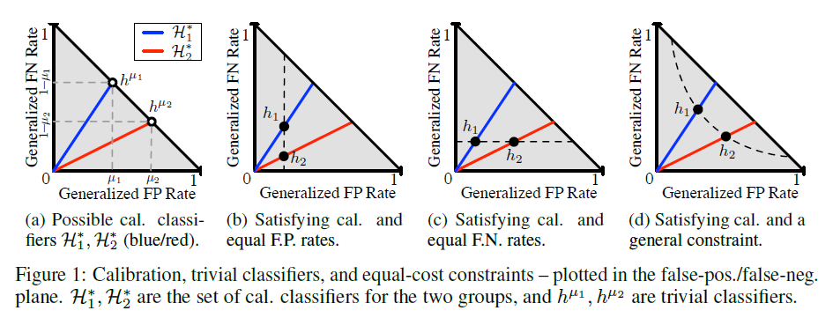
Error ratio parity – impossible to optimize fairly?
Notes:
Error ratios cannot be optimized without some cost to accuracy in the other group, or overall accuracy of the model (i.e. enforcing “fairness” means enforcing sub-optimal predictive value)

Slide 19

A tool we can use: re-sampling
Notes:
sample() function in R is very very useful!!

Slide 20


Neural networks
“Whisky on the rocks” 2022
wombo.art
“Whisky on the rocks” 2024
Midjourney
The state of the art for predictive analytics
Steep learning curve
Require dedicated packages
Difficult to interpret
Extremely powerful predictive tools

Slide 21
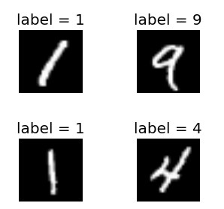
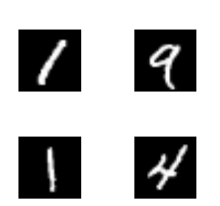
Neural networks are supervised models (mostly)
Supervised
Ground truth available
Unsupervised
Ground truth unavailable

Slide 22
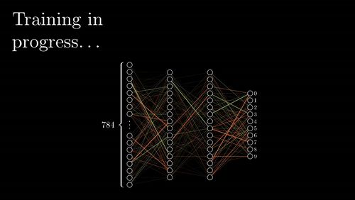
Artificial neural network (ANN) model

Slide 23

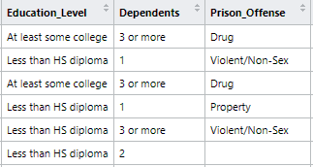
Artificial neural network (ANN) model
Did
recidivate?
Yes
No

Slide 24
Artificial neural network (ANN) model
Did
recidivate?
Yes
No

Slide 25
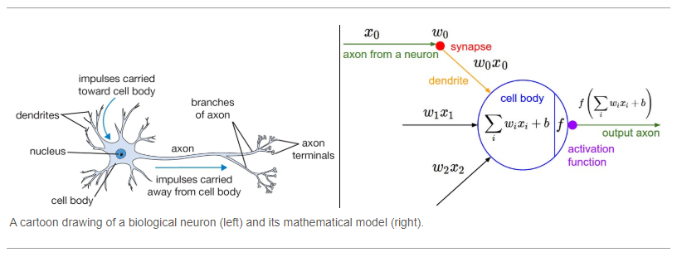
Artificial neural network (ANN) model

Slide 26
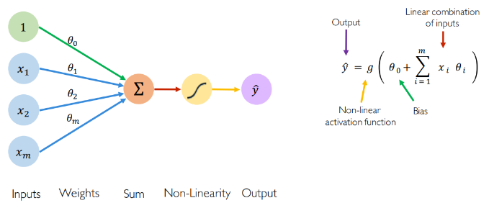
Artificial neural network (ANN) model

Slide 27
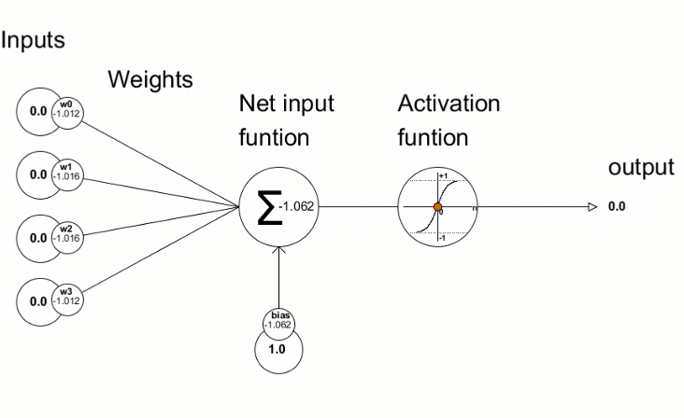
What makes a neuron fire – activation functions

Slide 28

What makes a neuron fire – activation functions

Slide 29
Learning from mistakes - backpropagation
Model
Error
== y?

Slide 30
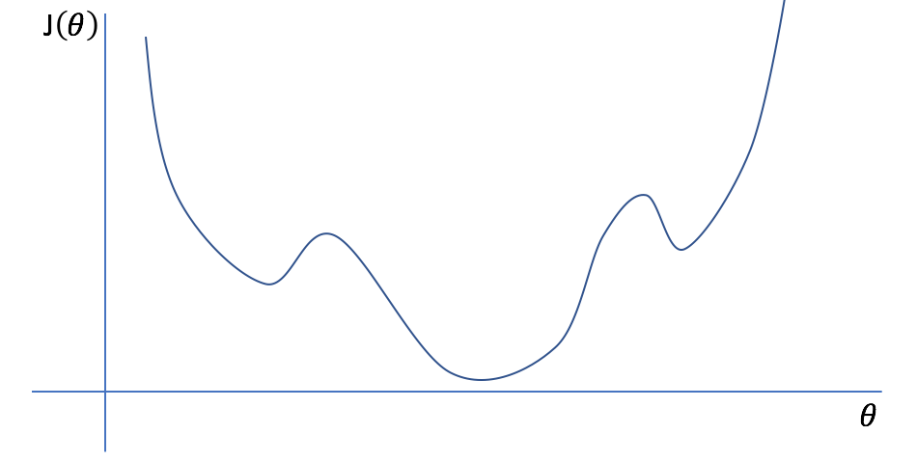
How to adjust weights – cost function
The process of adjusting weights IS the learning/fitting process
The cost function tells you which direction to adjust them
We don’t know the cost function
Learning rate
Cost
(e.g. RMSE)
Weight
Notes:
Rmse = root mean squared error – same thing we’d like to minimize when doing linear regression

Slide 31
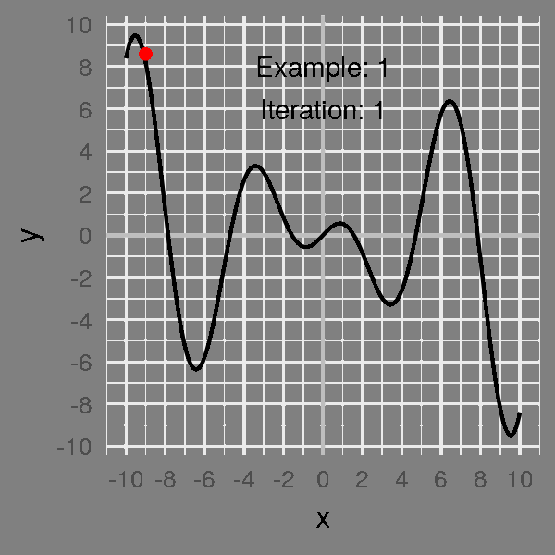
How to adjust weights – cost function

Slide 32
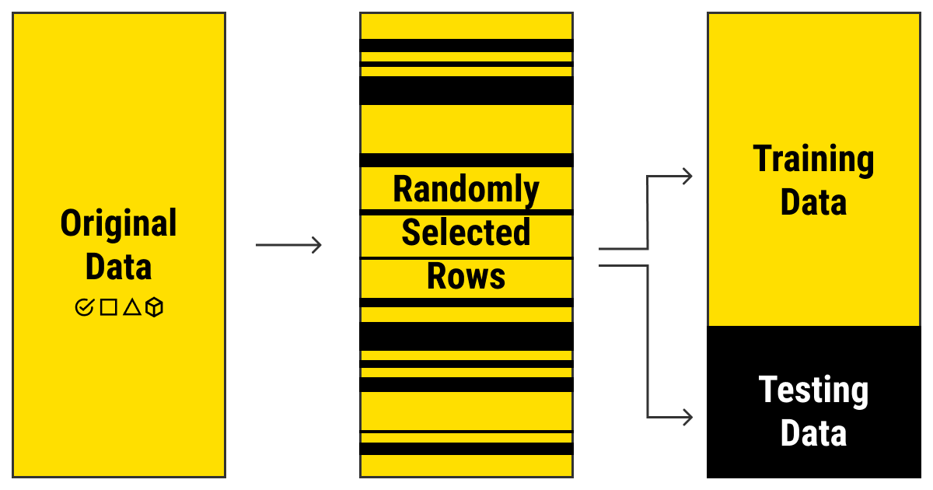
How to assess cost function – cross-validation
Splitting original data:
Training
Training data
Validation data
Testing

Slide 33
Minimize the cost function

Slide 34
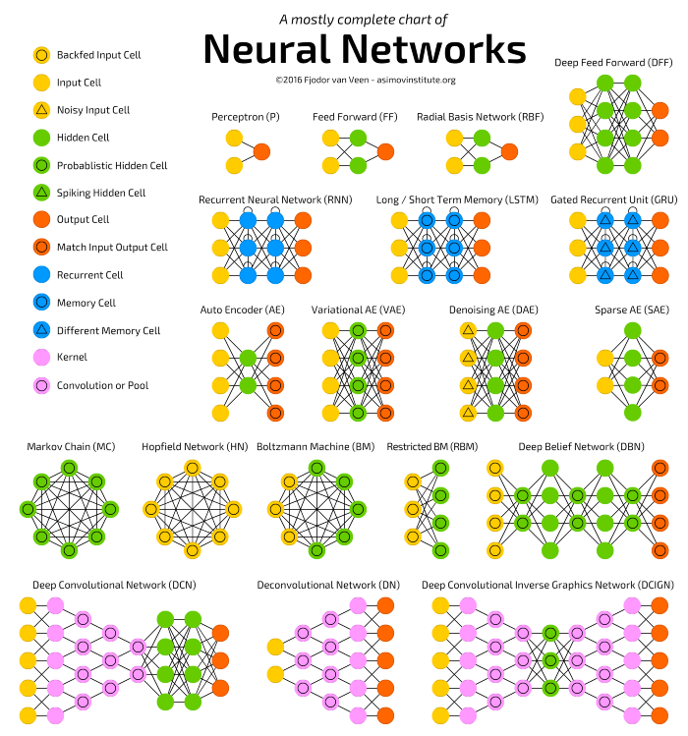
Endless network architectures

